Slide 1
Relational Algebra “Practice questions”

Slide 2



Slide 3




Slide 4
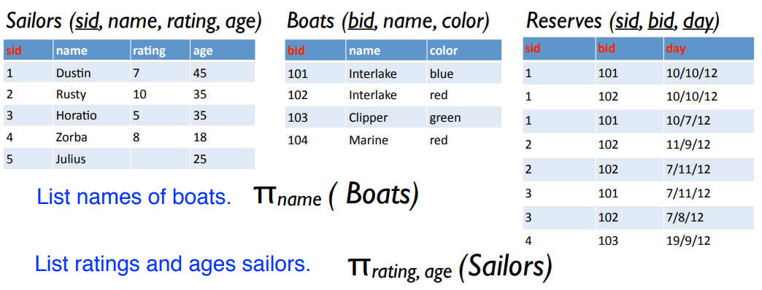

Slide 5

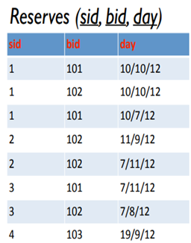
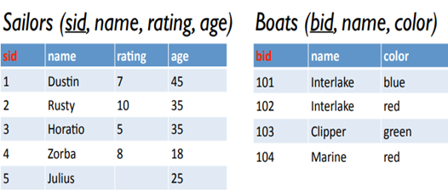

Slide 6
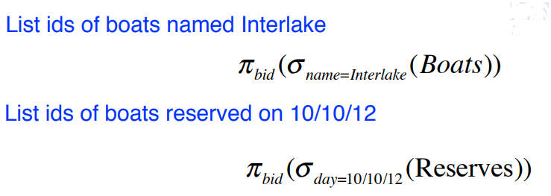

Slide 7
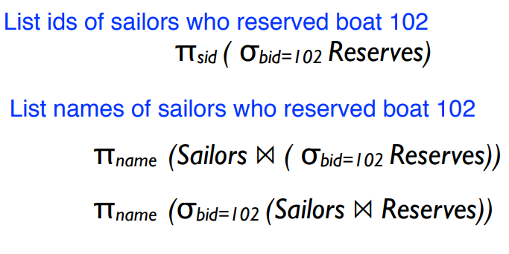

Slide 8
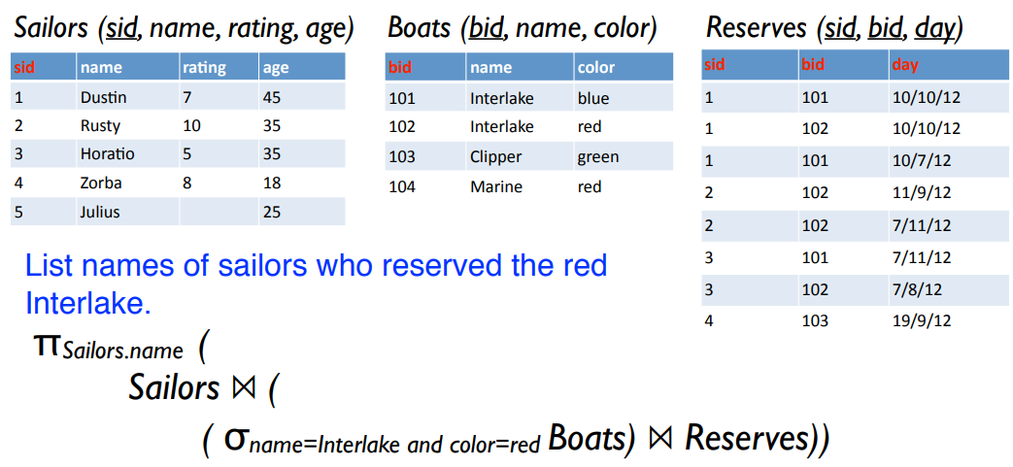
Query involving 3 relations

Slide 9
Link to Relax tool.
https://dbis-uibk.github.io/relax/landing
A video on how to use Relax tool
https://www.youtube.com/watch?v=oKEtu_3hp4o

